Slide 1


Slide 2



What is Aptis?
Aptis is an innovative English proficiency test for adults.
It is designed as an English test for adults, which can be used to assess language ability in all four English skills (speaking, listening, reading and writing).
Aptis consists of a core grammar and vocabulary component, which assesses a candidate’s knowledge.

Slide 3
GUIDELINES
IC
Pencil
Eraser
Mobile Phone on silent
Please raise your hand if assistance is needed.

Slide 4
Component | Number of questions | Time/ minutes | Method
Grammar & Vocabulary | 50 | 25 | Pen & Paper
Reading | 25 | 30 | Pen & Paper
Listening | 25 | 50 | Computer
Speaking | 4 tasks | 12 | Computer
Writing | 4 tasks | 50 | Computer

Slide 5

Grammar &
Vocabulary
This component consists of 25 multiple choice questions.
The Vocabulary Test consists of 25 questions in 5 sets.
In total the Grammar & Vocab test consists of 50 questions.
There is one mark for each correct answer.
The time allowed is 25 minutes.

Slide 6

Reading
This component consists of 4 parts containing 25 questions.
There is one mark for each correct answer.
The time allowed is 30 minutes.

Slide 7

Listening
This test consists of 25 short recordings and 25 multiple choice questions.
There is one mark for each correct answer.
The test takes approximately 50 minutes.

Slide 8

Speaking
This test consists of 4 tasks.
The candidates responses are recorded.
A maximum of 5 marks is available for each task.
The test takes 12 minutes.

Slide 9

Writing
This test consists of 4 different tasks.
A maximum of 24 marks can be earned in total.
The time allowed is 50 minutes.

Slide 10
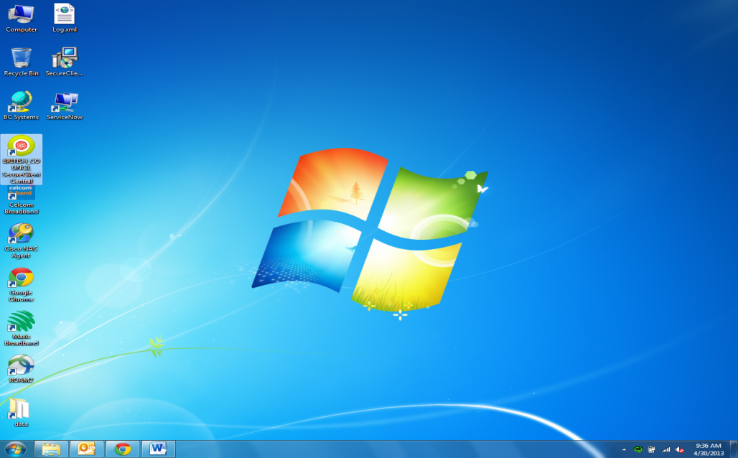
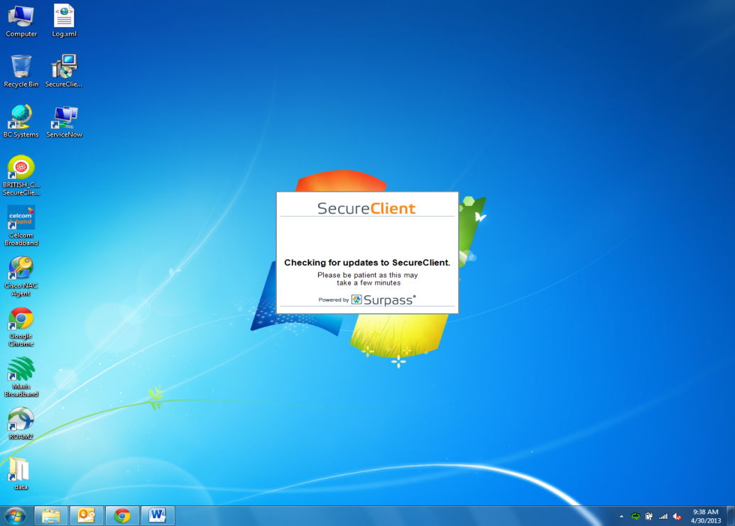
To launch Aptis, please double click on the desktop icon labeled “BRITISH_COUNCIL SecureClient Central”
It can take up to a few minutes for the program to open, please wait until the application is open.

Slide 11

PLEASE NOTE
You can edit all of your answers except for Speaking, Listening and task 3 of Writing.
When you have finished a computer component, you need to click Finish and then re-open the program.

Slide 12
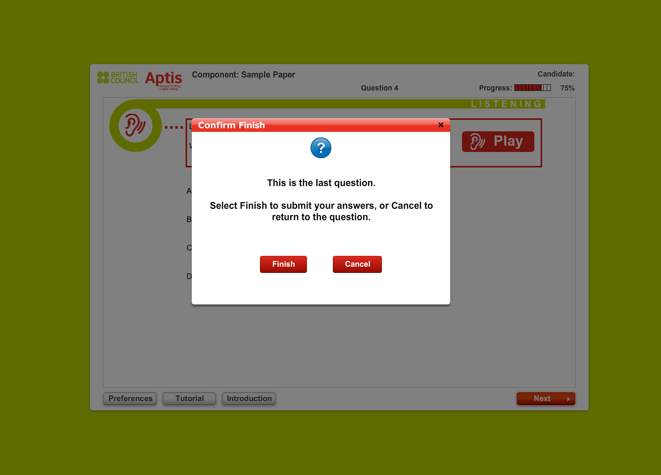
PLEASE NOTE
You can edit all of your answers except for Speaking, Listening and task 3 of Writing.
When you have finished a computer component, you need to click Finish and then re-open the program.

Slide 13
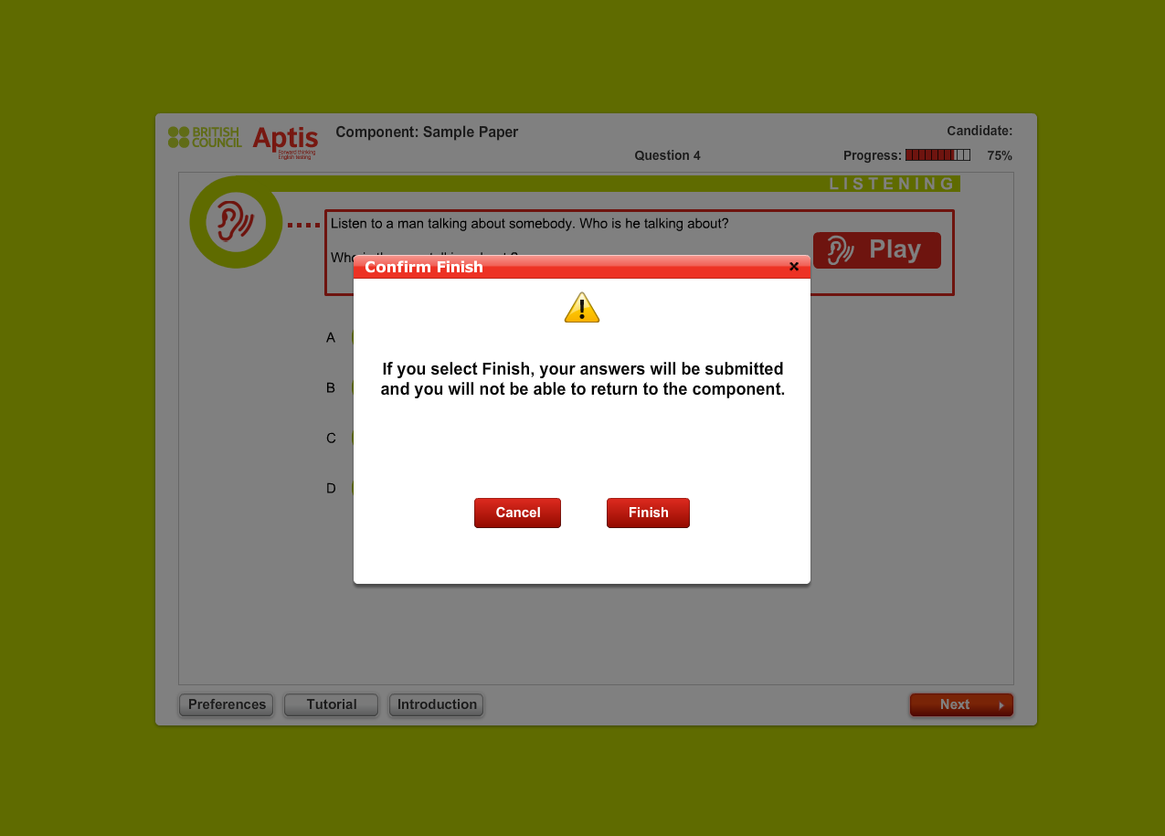
PLEASE NOTE
You can edit all of your answers except for Speaking, Listening and task 3 of Writing.
When you have finished a computer component, you need to click Finish and then re-open the program.

Slide 14
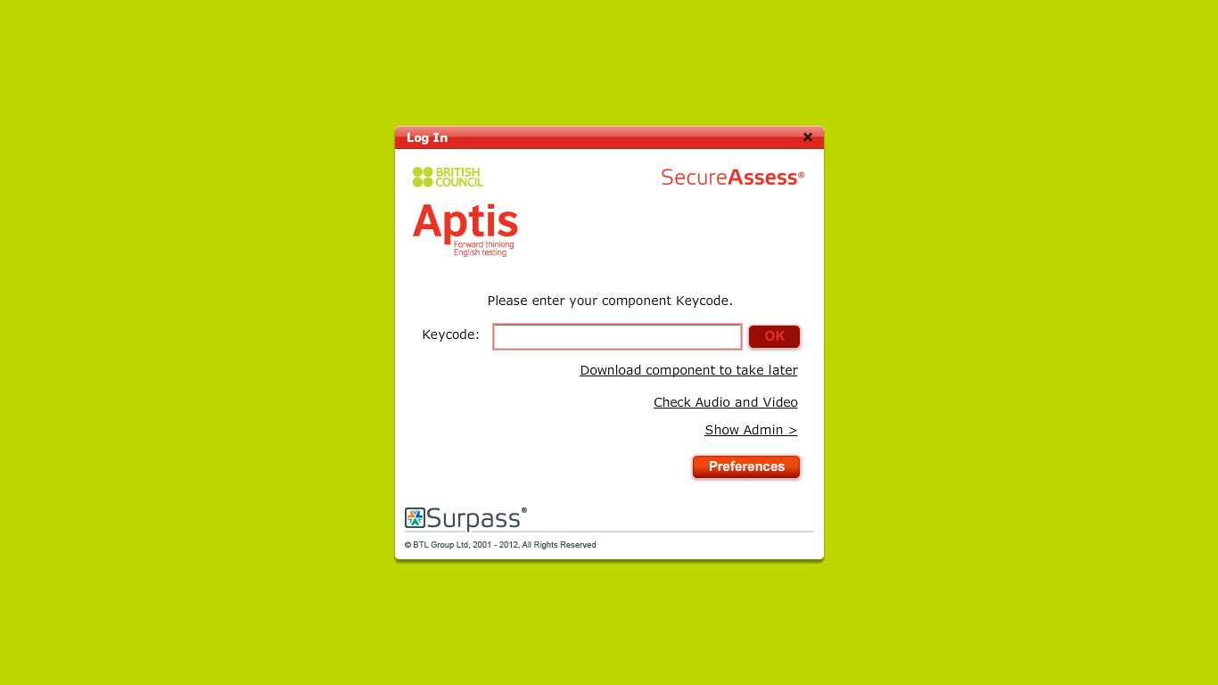
Click
Check Audio and Video
to test your headset

Slide 15
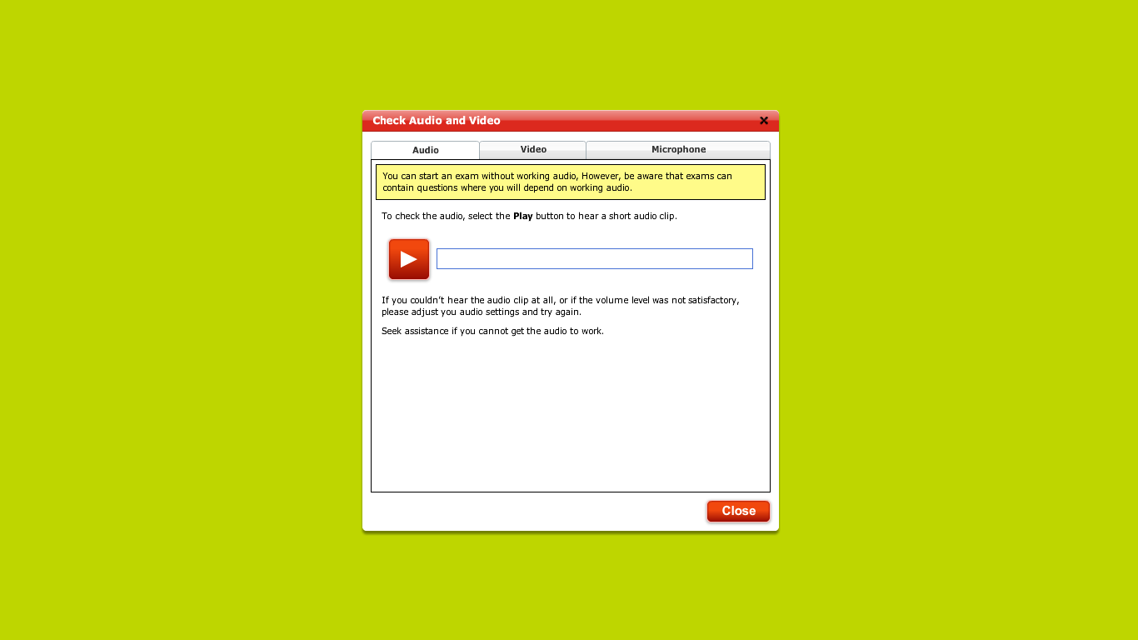
Click on the Video Tab And click on the movie
Click on the Microphone Button and test the headset microphone
Click on the Play Button to test the headset
Once tested, please click Close

Slide 16
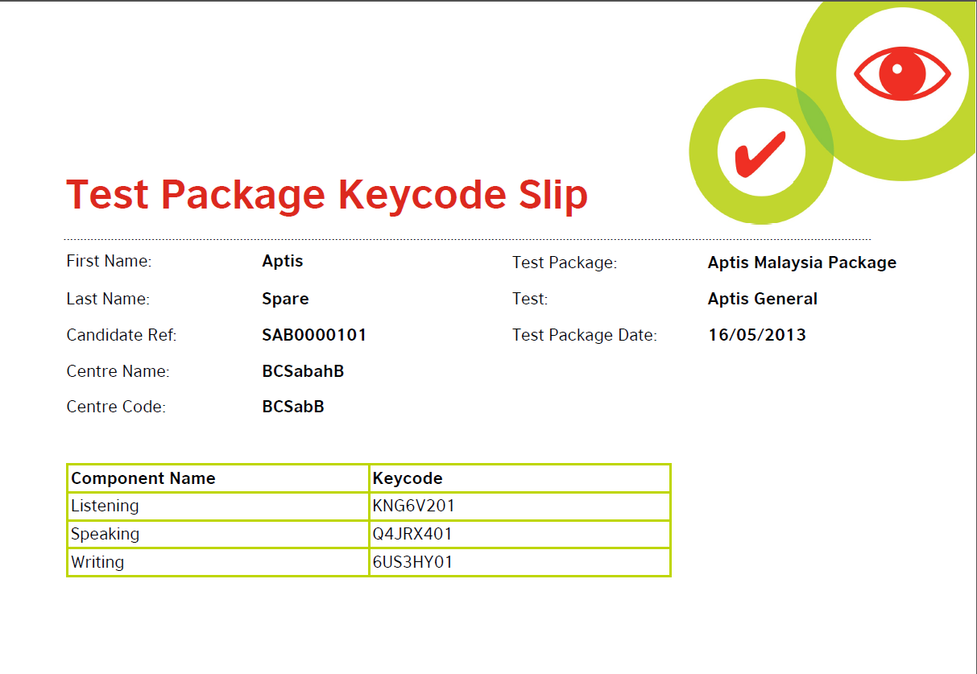
Your Keycode is a unique 8 digit code and is used to begin the exam.
You can only enter one Keycode per exam.

Slide 17

Input the Keycode here and click OK
Notes:
Try and get screenshots for the next 2 stages (candidate info & pin screen)

Slide 18
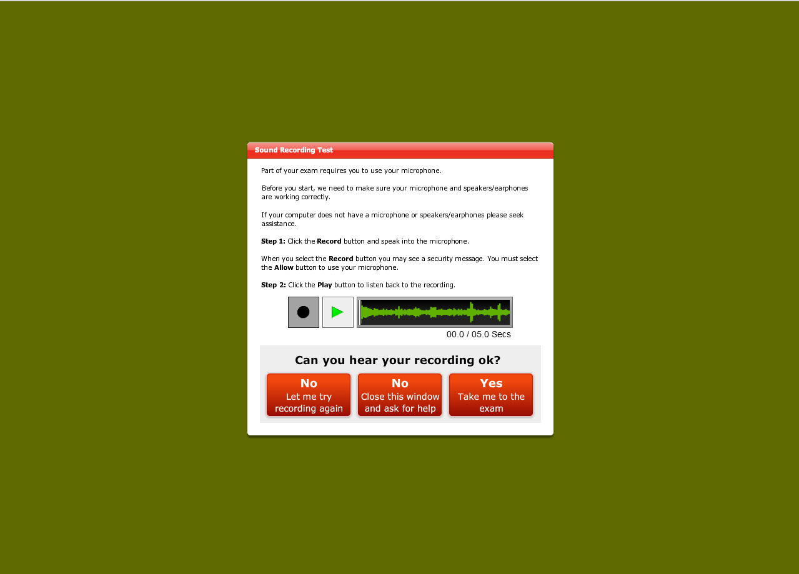
Before you start the Speaking exam, you will need to check your headset

Slide 19
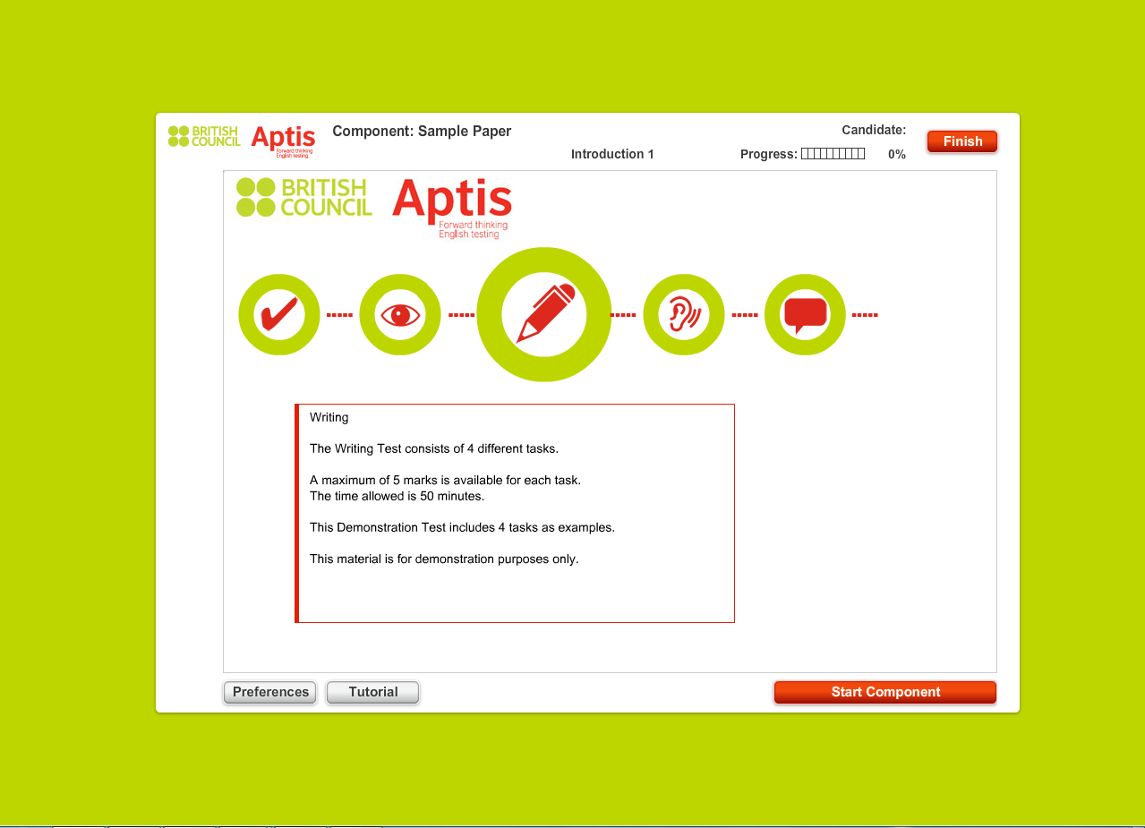
To start the exam, press Start Component

Slide 20

Please try a demo of the Aptis test here:
http://www.britishcouncil.org/exams/aptis/try-aptis

Slide 21

On behalf of the British Council we would like to wish you all
good luck!

